Slide 1
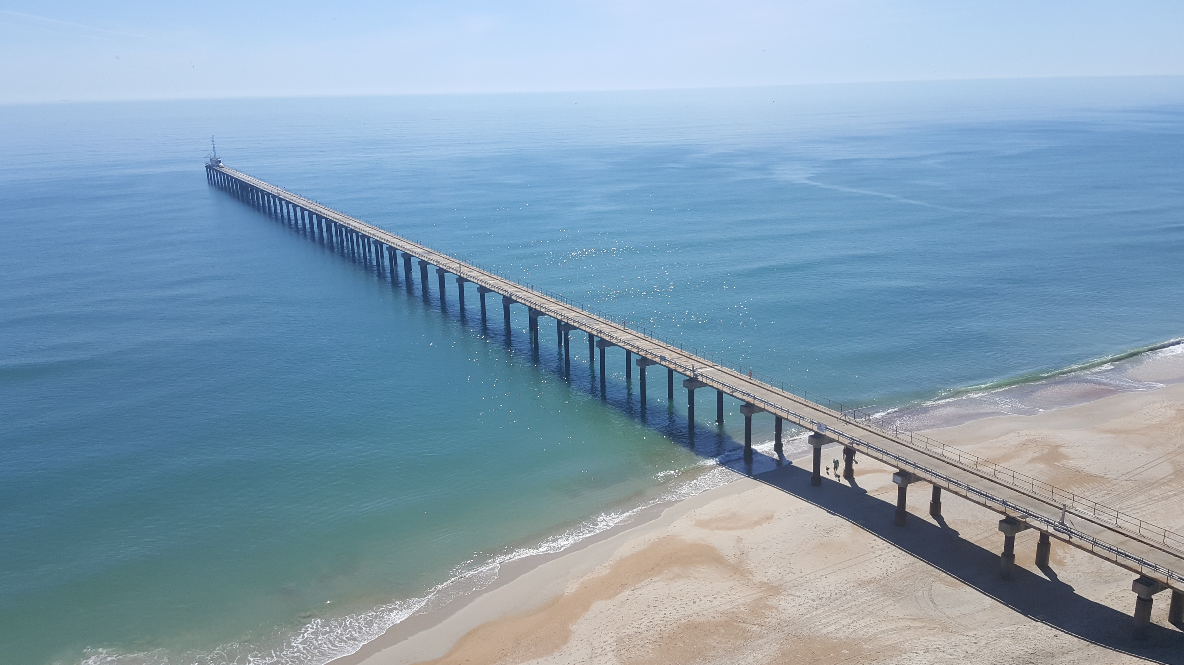
DUNEX 2021 Main Experiment

Slide 2
= File
DUNEXMainExp Directory Structure
= Folder
DUNEXMainExp
microSWIFT_data
document_templates
analysis
tools
README.md
DUNEXMainExp_Metadata.xlsx
dunex-venv-requirements.txt
getmicroSWIFTData.py
buildMissionNC.py
missionReport.py
missionReport.py

Slide 3
Example Mission netCDF Structure
Mission Layer
mission_0.nc
microSWIFT Layer
microSWIFT_25
Instrument Layer
GPS
IMU
Data Layer
imu_time
accel_x
accel_y
accel_z
mag_x
mag_y
mag_z
gyro_x
gyro_y
gyro_z

Slide 4
How to setup DUNEXMainExp environment on local machine
MacOS/ LINUX:
Windows:

Slide 5
microSWIFT Reference Frame for IMU
+X
+Z
+Y

Slide 6
General Deployment Workflow
Write down mission number
Look at forecast for wave conditions to determine deployment method
Look at deployment list and gather necessary equipment
Write down list of microSWIFTs to be deployed
Turn on and check all microSWIFTs to make sure they are working
Assign positions to each team member
Head to surf-zone to deploy microSWIFTs
Get microSWIFTs into surf-zone – write down time that last buoy entered the water
Retrieve microSWIFTs from surf-zone with help of shepard buoys
Check to make sure all microSWIFTs have been recovered with checklist – write down time last buoy recovered
Leave all microSWIFTs on and either redeploy for another mission or go back to trailer to offload
Transcribe all data from notesheet to DUNEXMainExp_notes.xlsx
Offload data by running getmicroSWIFTData.py
Build mission netCDF with buildMissionNC.py
Write mission report with missionReport.py
Backup data using backupmicroSWIFTData.py
clean and shut down all microSWIFTs and put on chargers for the next day

Slide 7
Surfboard Arrays
Conditions for Surfboard Array:
Forecasted Hs < 4 ft and people are comfortable and happy to go in the water (safe conditions)
Two Cross-Shore Lines
Small Grid
South
North
South
North
Cross Shore Distance [m]
Cross Shore Distance [m]
Depth [m]
Depth [m]
AS
AS
XS
XS
Along Shore Distance [m]
Along Shore Distance [m]
NOTE: cross shore lines start on outside of surf-zone but had to show on this figure.
How to deploy Small Grid:
Fill each surfers backpack with 5 microSWIFTs
Each surfer paddles out past break and drops line of 5 microSWIFTs in closer lines to pier
Remaining crew drops 5 more microSWIFTs from pier to each surfer
Each surfer paddles alongshore and each deploys a line of 5 more microSWIFTs past the break
Total: 20 microSWIFTs
How to deploy Two Cross-Shore Lines:
Fill each surfers backpack with 5 microSWIFTs
Each surfer paddles out past break and drops line of 5 microSWIFTs in line
Remaining crew drops 5 more microSWIFTs from pier to each surfer to deploy just inside of break
Total: 20 microSWIFTs
Notes:
Check list for Paddle Array:
Note sheet
microSWIFTs
Surfboards (2)
Wetsuit/Swimsuit
Gator for recovery
microSWIFT Rack
Radios

Slide 8
Jetski Arrays
Conditions for Jetski Array:
4 ft < Forecasted Hs < 10 ft and lifeguards are comfortable taking microSWIFTs out
Two Along-Shore Lines
Large Past-Break Grid
South
North
South
North
Cross Shore Distance [m]
Cross Shore Distance [m]
Depth [m]
Depth [m]
AS
XS
Along Shore Distance [m]
Along Shore Distance [m]
How to deploy Two Along-Shore Lines:
Give Jetski 20 microSWIFTs and ask to deploy in a semi-uniform line by dropping them behind them
Refill a bag with 20 more microSWIFTs and give back to the jetski operator to deploy in the same way
( will the jetskis come to the beach to meet us or will be throw them over the pier?)
Total: 40 microSWIFTs
How to deploy Large Past-Break Grid:
Give jetski operator 20 microSWIFTs and ask to deploy in a semi-uniform grid on south side of pier by dropping them behind them inn “lawn-mowing” pattern
Refill a bag with 20 more microSWIFTs and give back to the jetski operator to deploy in the same way on the north side
(Need to be careful of Britt and Steve’s pipes on north side)
Total: 40 microSWIFTs
Notes:
Check list for Paddle Array:
Note sheet
microSWIFTs
Surfboards (2)
Wetsuit/Swimsuit
Gator for recovery
microSWIFT Rack
Radios

Slide 9
Launcher Arrays
Conditions for Launcher Array:
Forecasted Hs > 10 ft and High winds and conditions safe enough to go on pier/deploy
Two Far Clusters, Three Close Clusters
South
North
Cross Shore Distance [m]
Depth [m]
AS
XS
Along Shore Distance [m]
How to deploy Two Far Clusters, Three Close Clusters
Launch five microSWIFTS from the launcher off each side of the pier
Throw 10 additional microSWIFTs by hand off each side of the pier
Throw 10 more microSWIFTs by hand from the end of the pier
Total: 40 microSWIFTs
Notes:
Check list for Paddle Array:
Note sheet
microSWIFTs
Surfboards (2)
Wetsuit/Swimsuit
Gator for recovery
microSWIFT Rack
Radios

Slide 10
Helicopter Arrays
Conditions for Helicopter Array:
Forecasted Hs > 10 ft and Low winds and conditions safe enough that pilot is comfortable
Large Grid
South
North
Cross Shore Distance [m]
Depth [m]
Along Shore Distance [m]
How to deploy Two Along-Shore Lines:
Deploy microSWIFTs in semi-uniform large grid pattern from the helicopter starting with furthest offshore line and working towards shore
Total: 50 microSWIFTs
Notes:
Check list for Paddle Array:
Note sheet
microSWIFTs
Surfboards (2)
Wetsuit/Swimsuit
Gator for recovery
microSWIFT Rack
Radios

